Slide 1
Data Structures
Lecture-17
Binary Trees
Prateek Narang

Slide 2
Any Doubts?
Notes:
Make them create one file from next time

Slide 3
Binary Trees
Notes:
Make them create one file from next time

Slide 4
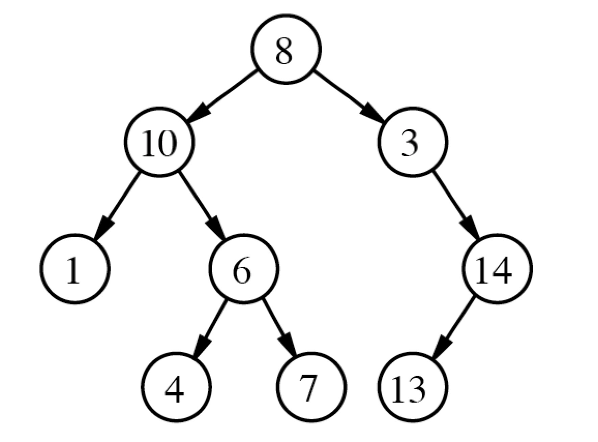
Binary Trees
Notes:
Talk about circular linked list

Slide 5
Binary Tree Node
class node{
int data;
node* left;
node* right;
}
Notes:
Talk about circular linked list

Slide 6
Input & Output
Take Input
Print
Notes:
Talk about circular linked list

Slide 7
Lets discuss a problem
Count number of Nodes
Find diameter of a binary tree
Notes:
Talk about circular linked list

Slide 8
Your Turn
Find a node in Binary Tree
Mirror a binary tree
Notes:
Talk about circular linked list

Slide 9
Another Traversal for Binary Trees
Inorder Traversal
Notes:
Talk about head of linkedlist

Slide 10
Building tree using Preorder and Inorder traversal
Notes:
Make them create one file from next time

Slide 11
Building tree using Postorder and Inorder traversal
Notes:
Make them create one file from next time

Slide 12
Building tree using Preorder and Postorder traversal
Notes:
Make them create one file from next time

Slide 13
Prateek Narang

